Slide 1
Lecture 8 Insertion Operation of Linked List
Prepared By:
Afsana Begum
Lecturer,
Software Engineering Department,
Daffodil International University.

Slide 2
Contents
Insertion methods at any position
Algorithm of Insertion

Slide 3
Inserting a new node
Possible cases of Insert Node
Insert into an empty list
Insert in front
Insert at back
Insert in middle
But, in fact, only need to handle two cases:
Insert as the first node (Case 1 and Case 2)
Insert in the middle or at the end of the list (Case 3 and Case 4)

Slide 4
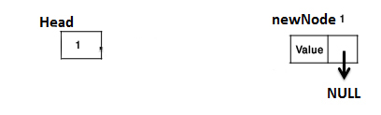
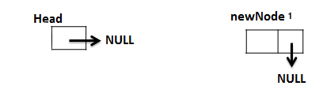
Inserting at Beginning
Start
10
15
20
null
START
22
15
20
null
10
NEW

Slide 5
Inserting at Beginning
Step 1. Create a new node and assign the address to any node say PTR .
Step 2. OVERFLOW,IF(PTR = NULL)
write : OVERFLOW and EXIT.
Step 3. ASSIGN INFO[PTR] = ITEM
Step 4. IF(START = NULL)
ASSIGN NEXT[PTR] = NULL
ELSE
ASSIGN NEXT[PTR] = START
Step 5. ASSIGN START = PTR
Step 6. EXIT

Slide 6
Insertion in the Middle
Node N is to be inserted in to the list between nodes A and B
Three pointer fields are changed as follows:
The next pointer field of node A now points to the new node N, to which AVAIL previously pointed.
AVAIL now point to the second node in the free pool, to which node N previously pointed.
The next pointer field of node N now points to node B, to which node A previously pointed.
START
Node A
Node B
START
(a) Before insertion
Node A
Node B
AVAIL
(a) After insertion
Node N
Node N
Free storage list

Slide 7
Inserting a new node
INSLOC(INFO, LINK, START, AVAIL, LOC, ITEM)
[OVERFLOW?] If AVAIL=NULL, then print OVERFLOW and exit
Set NEW= AVAIL and AVAIL=LINK[AVAIL] (Next)
Set INFO[NEW]= ITEM
IF LOC = NULL then [Insert as first Node]
Set LINK[NEW]= START and START=NEW.
Else: [Insert after node with location LOC]
Set LINK[NEW]= LINK [LOC] and LINK[LOC]= NEW
Exit.
Insert as first element
START
NEW

Slide 8
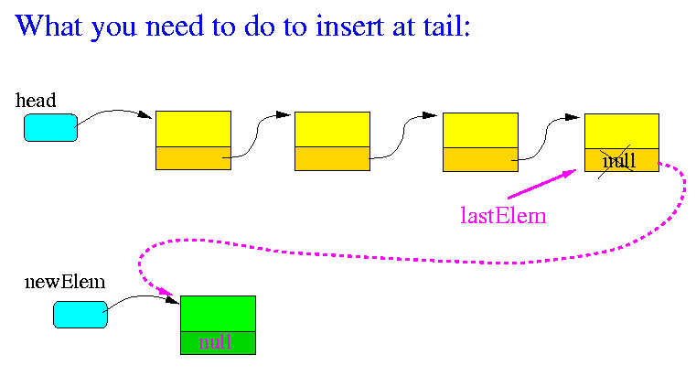
Insertion in the last position

Slide 9
Inserting a new node
INSLASTLOC(INFO, LINK, START, AVAIL, LOC, ITEM)
[OVERFLOW?] If AVAIL=NULL, then print OVERFLOW and exit
Set NEW= AVAIL and AVAIL=LINK[AVAIL] (Next)
Set INFO[NEW]= ITEM
4. Set LINK[NEW]= NULL and LINK[LOC]= NEW
Exit.

Slide 10
Question?

